Slide 1
Group 75 - Advisory Model Report Company A
Axel Ehrnrooth - 2733678 Kevin Brachthuizen - 2702224
Dirk de Boer - 2663349 Guido Takkenberg - 2640724

Slide 2




Team Magnum
Axel Ehrnrooth - 2733678 Kevin Brachthuizen - 2702224
Dirk de Boer - 2663349 Guido Takkenberg - 2640724

Slide 3
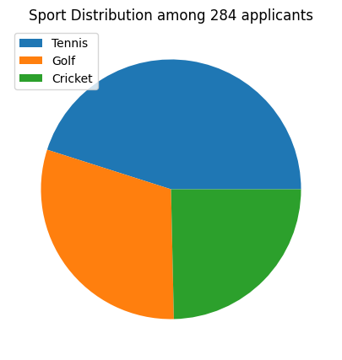
Company A Applicant Dataset
284 Total applicants
All applicants play 1 sport each:
Tennis: 128 People
Golf: 86 People
Cricket: 70 People

Slide 4
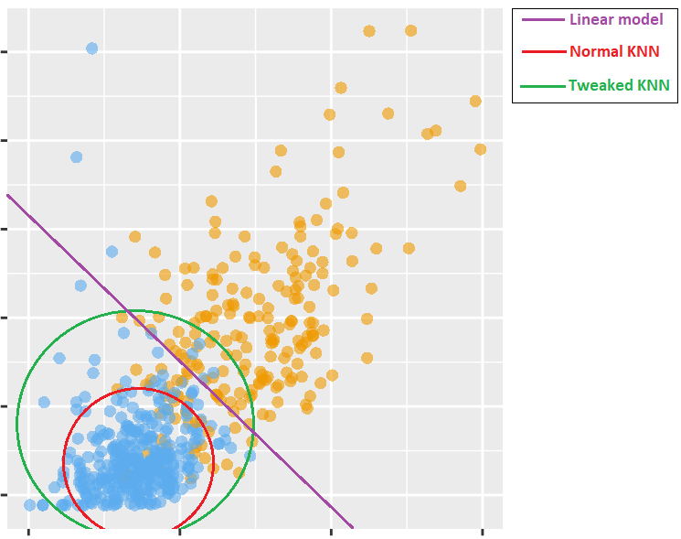
Model Techniques Utilised
Hypothetical representation of Models
Decision Tree Model:
Traditional Exploration
Logistic Regression:
Generalises Dataset
KNN Model:
Simple Implementation
Reduced costs
Cluster Recognition
Minimise wasted applicants
Flexible for adaptation
Notes:
k-NN:
Reasoning
Simplicity is comparable to that of linear models
Has the ability to classify similarly to how more complex models (like NN’s) classify
Does so without needing much computing power.

Slide 5
Validation Approach
Cross-validation
Train_test_split
Stratified
Grid search hyperparameters
Sklearn’s inbuilt hyperparameter search
Manual search around found optimum
Recall
Minimize wasted applicants
Assumption: Model used for preselection, not final selection
Notes:
Cross-validation
Used the built in train test split from scikit-learn to split the data
Stratified the sets so that the ratios of classes in the sets represent the real ratios in the data.
Used Grid search to find hyperparameters
Used scikit-learn’s built grid search system
However, a small manual search was done around the found parameters
Necessary in some cases to find even better parameters
Grid search not always perfect
Focus on the Recall
The cost of losing a suitable candidate for a position is higher than that of having to reject one later that is not suitable.
The assumption here is that the model will be used to recommend applicants to a later stage of hiring, narrowing down total applicants that will move on
If the model will have a different purpose, a different metric might be more suitable

Slide 6
Data Inputs Used
Choices based on data exploration
Which features seem to influence the decision?
Cost of features taken into account → not too many.
As uniform as possible.
Tree and KNN models:
Age, University grade, Entrepreneur experience and International experience.
Logistic regression model:
Age and University Grade.
Does not work well with booleans.
Notes:
Choices for features were made using graphs made during data exploration:
We looked at which graphs and features in those graphs seemed to show the most correlation to the decision.
This did not necessarily have to be a strictly linear relation
The cost of collecting data on a feature was taken into account → Not too many features could be implemented, so only the most useful or interesting ones were included
We tried to keep the features used for the model as uniform as possible, wherever possible
For the decision tree and the KNN model, this boiled down to four features:
Age: some ages seemed to be more prevalent when looking at people who were hired
University grade: The extremes of this feature seemed useful for ‘easy’ rejections or accepting for the model
Entrepreneur and International experience: the combination of both seemed to be valuable in determining whether a candidate would be hired
For the logistic regression model, there were some limitations:
When using the boolean columns for both experiences, the model stopped working well → recall became 0 (the model only guessed false for all cases)
The other two columns did work

Slide 7
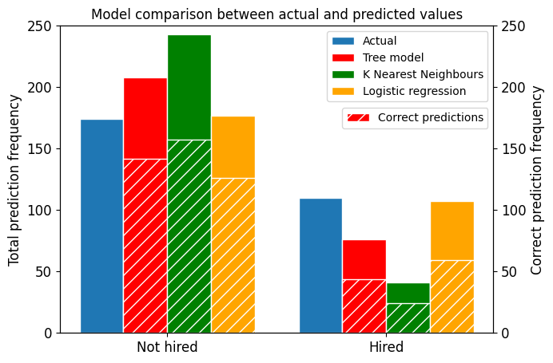
Model Cross Evaluation
KNN and Tree both biased towards ‘not hired’ significantly
Skewed Dataset affects bias
KNN performs worst
KNN finds wrong clusters.
Recall of logistic regression highest
Logistic regression little to no bias (in this dimension)
Notes:
Both KNN and the decision tree exhibit a bias towards false → they are more likely to predict an applicant to be denied than the other way around.
A possible reason for this could be that the original dataset is skewed somewhat, and the model exaggerate this.
We can see that the KNN model and the decision tree also have a lower recall, making them a less desirable option for our implementation
KNN probably did not find correct clusters, or ‘found’ clusters where there were none.
Logistic regression had the highest recall
it did not just hire the most applicants but also correctly hired more applicants than any other model.
(Optional comment) It correctly hired more people than k-NN hired in total.

Slide 8
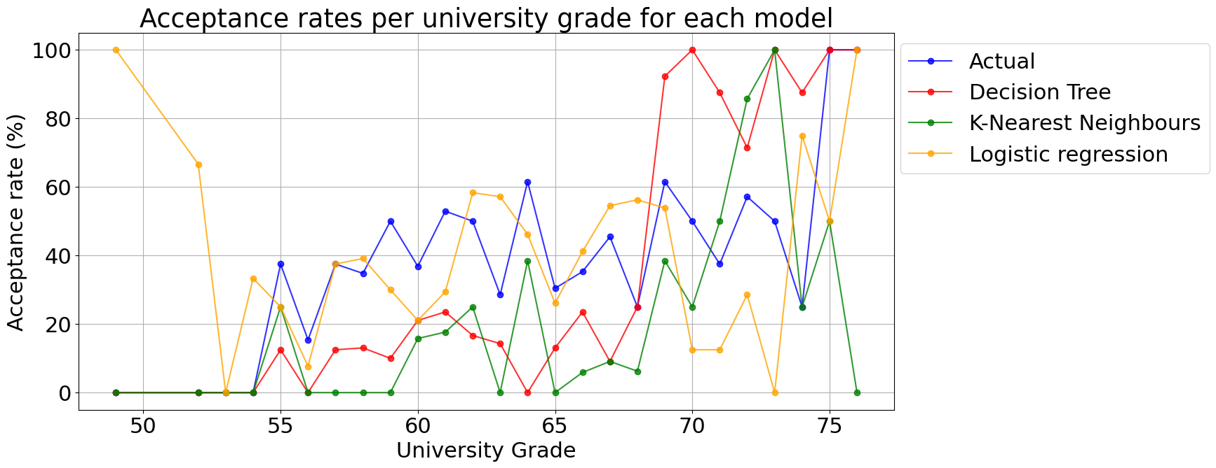
Model Cross Evaluation
Decision Tree focus on high grades
KNN volatile in predictions
Extreme peaks
Logistic regression less reliable on extremes
Limited Data
Logistic regression mirrors Actual progression
Generally, Logistic regression performs best
Notes:
We can see that the decision tree has a very large bias towards higher grades, accepting most people with a grade above 69
On the other hand, KNN seems very harsh in its decisions, having some extreme peaks before returning back to zero completely
Linear regression is less accurate on the lower end of the grade spectrum. A possible explanation is that this end of the data has little representation in the dataset.
Furthermore we can see that above grades of 54, the linear regression model follows the actual acceptance rates relatively closely (with some deviations of course).
All in all, the logistic regression model performs best, especially when it comes to recall as discussed earlier.

Slide 9
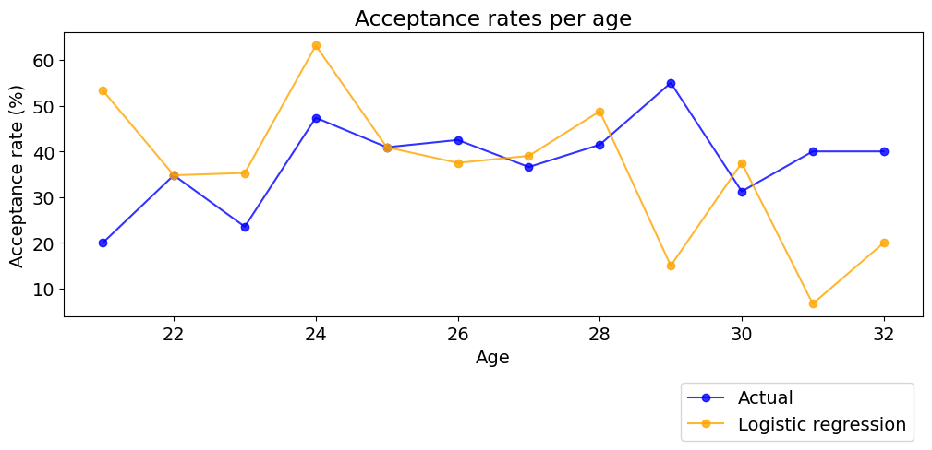
Bias Analysis
Logistic Regression introduces multiples Biases
Bias towards younger ages introduced
Light bias towards men
Particularly younger ages
Bias increased towards Hiring Belgians
Mild presence in original data
Possibly due to company’s location
Notes:
Although it performs relatively well, the logistic regression model still has its flaws.
For example, it introduces or exaggerates some biases.
A large bias that is introduced is the one towards younger applicants, or more accurately, against older people.
There is also a small bias towards men (especially in the younger age range again)
An interesting bias is one that is present towards belgians. There seems to be a slight preference towards people from Belgium.
This is also present in the original dataset. However it is slightly exaggerated in the model
The original bias could be due to company location

Slide 10
Implementation Recommendation
Recommended model: Logistic regression
Use as applicant recommendation
Oversight and operation recommendations:
Adjust “decision” column
Rejected - Approved
Avoid biases due to limited job availability
Annual hiring review to spot emerging bias
Collect data and retrain model periodically
Notes:
We recommend the logistic regression model is used in a recommendation application → Rather than making the final decision, the model should assist in narrowing the group of people who have to be further examined.
To ensure the model keeps working correctly, and to possibly address biases:
We recommend changing the column of decision
Hired/not hired might limit the data in this category from people who are eligible for a job, to people who got one
Changing to rejected/approved might help the model give better recommendations
This would avoid biases that are introduced due to limited availability of jobs
For example, the bias towards belgians could simply be due to a higher availability in this region
We also recommend that the models’ predictions are reviewed periodically, to ensure it is not developing (or has developed) a bias that is too great or significant
Finally, we recommend collecting data while using the model and hiring employees, and retraining the model on this data every once in a while
This way, the model will somewhat reflect company changes, and can be adjusted according to desires.

Slide 11
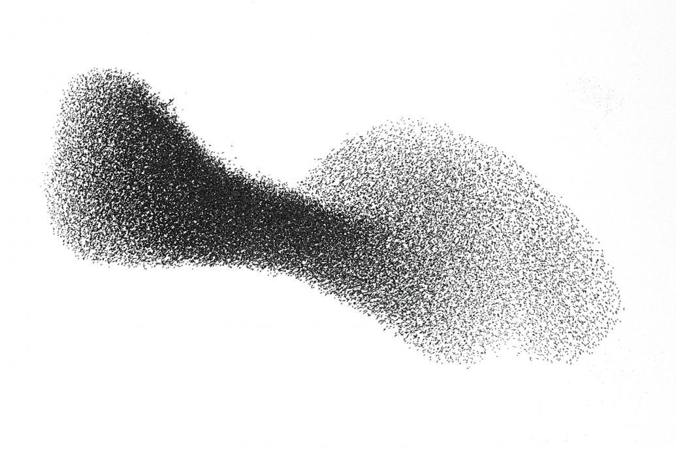
Any Questions?
Thank you for your time

